Slide 1
Partners in Parenting Education Step 4

Slide 2
Evaluation
Notes:
Thinking about our existing skills as family nurses and what we have learnt about the model so far we are now going to think about evaluation and consider its importance in PIPE
We will use the knowledge that you have gained from Steps 1,2,3 and combine with your existing skills as family nurses to further develop your competence and confidence in this last stage

Slide 3
What are we evaluating?
Step 4 like Step 1 has TWO parts
Evaluating the caregiver/child interaction
Evaluating the topic
Growth mindset
Notes:
Go through slide, offering the question about who will be the best evaluator. The baby/child will often be the best evaluator and encourages skilled observation. Highlight the two parts, this is key
Just like any learning activity we are going to evaluate what went well and what would be “even better if”….this is key to continuing growth and development and helps support a growth mindset.
Briefly outline how this supports a key underlying theory of FNP of self efficacy/self belief
Having a growth mindset (the belief that you are in control of your own ability, and can learn and improve) is the key to success. Yes, hard work, effort, and persistence are all important, but not as important as having that underlying belief that you are in control of your own destiny

Slide 4
Evaluating the topic
Please turn to page 262 and read Step 4
There are a number of ways to evaluate
Face check handout
Notes:
The final part of the model, is to get an overview of what the client feels they have learned
When doing this the usual FNP skills apply – you want to recap and check for learning/integration, as you would when facilitating any other learning opportunity.
You may use a suggested parent hand out or an activity to facilitate this such as facecheck handout (add this to files/chat and/or send with prelearning information)
So lets finish our thinking and relating this back to the topic we have been focusing on. Please turn to page 262 and read step 4.
So you will notice that there are a number of ways to evaluate suggested on pg 262. You can choose these or use your appreciate feedback process and something as simple as the Face Check handout. Show a copy of the face check handout, this will be provided for each delegate, share on screen for online version, add to files
You’ll also notice at the top of p263 there are some topic enhancers and just to let you know these offer additional resources that could extend the parent learning or you may agenda match together in your goal setting between visits

Slide 5
This handout is in FILES on TEAMS.
It’s a VERY handy way to evaluate a PIPE activity…….worth having a few in your bag….

Slide 6
Evaluating the topic
Giving good feedback, using existing FNP skills
Being appreciative
Your communication style
OARS
EPE
Triggers for change
Notes:
Go through the slide, key learning points as follows:
In terms of our role and the value of offering appreciative feed back, checking out what the parent has learnt, what the parent would like to think of a little more? We have some skills that will enable this to happen in a positive, affirming way.
So when giving feedback in step 4 lets think together about our approach
Which communication style would we use predominantly? Ask participants – Guiding.
Giving appreciative feedback- asking the client, what do you feel went well?
Could you do anything to make it even better?
Seek permission to offer further feedback
Check to see if the client has any further questions, use your OARS!
Open questions (more than a yes / no answer)
Affirmations – why? - affirming strengths, strategically designed to anchor client to his / her strengths
Reflections – why more helpful than lots of questions? Can we remember types – content, feeling, meaning
Summaries – sums up, picks up on what seems most important
If you need to share anymore information remember the process of EPE – Elicit provide elicit
Then within the discussion you may hear:
Triggers for change – A connection with something of intrinsic value, something important, their hearts desire.
PIPE provides an amazing opportunity to work with any trigger for change, embrace the creativity, the opportunity to trigger emotions
Think about how PIPE will support agenda matching
The possibilities in terms of agenda matching – ‘what's important to you’, ‘what can I share with you’.

Slide 7
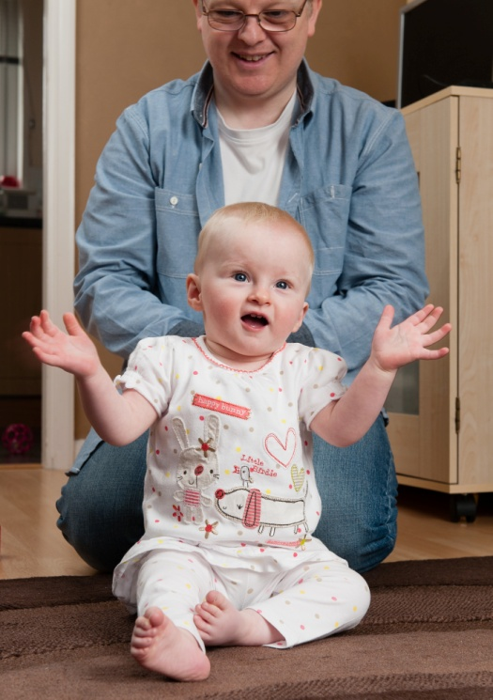
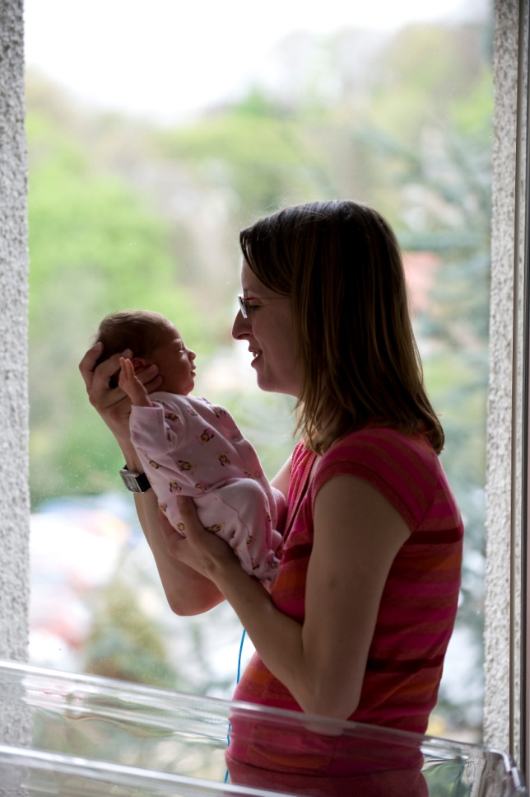
Evaluating the interaction
Notes:
In terms of the interaction itself:
Naturally the best evaluator will be the baby (hopefully identified in the previous slide)
Is the baby enjoying the activity? How will you know? Reflect back to what we explored at Next Steps in relation to baby cues.
Ask for some key aspects of baby cues that would signal engagement using Raise Hand or chatbox
Are parent and baby sharing a positive experience? if not does the parent know how to adjust, how can you help? Consider using DANCE language here so that nurses are introduced to this (complementing affect, visual engagement, positioning, completes interaction etc etc_
While you are observing in step 3, you are processing what you see and thinking about what you might say, just as you did when watching our client in the DVD. You then call on this to offer back to the client.
This all comes with a wee word of caution………what traps might we fall into as we offer feedback and evaluation?
NEXT SLIDE

Slide 8
Evaluating the interaction: potential pitfalls
Righting reflex
Persuasion traps
Overuse of questions
Notes:
Pitfalls – things that will trip us up and get in the way of communication and ultimately the relationship
Righting reflex – will generate resistance
Persuasion traps – expert, power
Questions – feels like interrogation
So bearing these pitfalls in mind, let’s think about how we can offer feedback and evaluate the interaction
NEXT SLIDE

Slide 9
Offering feedback
Thinking back to the conversation you saw between mum and baby in Step 3 how would you begin a conversation with this client?
Please use Raise hand to share your thoughts or add to chat (if we have time we may skills practice….)
Review any notes you made in Step 3
Notes:
If time allows offer this as a skills practice, if time is short, facilitate group feedback
Introduce skills practice
In 3’s –one of you be the client, one be the FN and one be the observer.
Begin a conversation with the spirit of FNP and give feedback to the client about what you noticed- how she interacted with the child your reflection sheet will help you- take 5 mins and then can the observer give some appreciative feedback. Only do this once and then come back to the main area

Slide 10
Feedback in more challenging situations
Roly Poly DVD
Notes:
Watch the Roly Poly clip (DVD) and then facilitate a discussion to explore how the FN would offer feedback to this client
If unable to view this clip facilitate a discussion about how we may go about providing feedback when the interaction is not so positive. Strength based, using the voice of the child about how they might feel etc

Slide 11
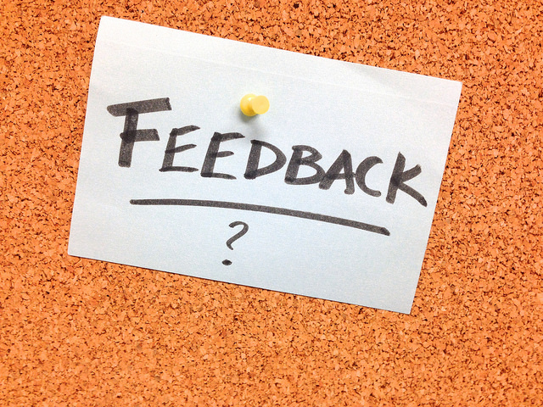
Following feedback…………
ROLY POLY after feedback
Notes:
Show roly poly DVD following the parent receiving feedback, highlight that this is better and with support the interaction will continue to improve

Slide 12
The final mile…………
PIPE is a 4 step model
Step 1: Presentation of concepts
Step 2: Demonstration
Step 3: Supervised Parent-Child Interaction
Step 4: Evaluation
Notes:
You have done some back ground reading and we have thought about the value of the PIPE resources and using this model in practice – the opportunities and power.
Offer a summary of the online session
We have spent the last two sessions looking at the PIPE 4 step model and you have had a chance to practice within each step of it.
We have viewed an entire PIPE lesson and then we have deconstructed it to build it up again, step by step.
Provide opportunity for questions and offer some initial thoughts for supporting integration into practice

Slide 13
Plans for the next stage in your PIPE journey
Putting the jigsaw together…..
You have all been paired with a colleague in this cohort. Make sure you know who they are and what their Teams name/email is
Each pair/trio has been allocated a PIPE topic to develop your lesson plan together.
Once you are happy with your lesson plan, we are asking you to meet on Teams and skills practice, each taking the role of nurse and client
In **** a colleague from the Education team will complete your observation of your PIPE lesson over Teams (this may be how you need to deliver PIPE to your clients)
Your partner and observation slot will be shared with you today……..
Ta Dah! You made it!!!
Notes:
If skills practice observations require to be completed over TEAMS/online work through this slide and take questions. Where possible explore skills practice observation within a classroom setting (small groups/physical distance allowing).
Consider using the Observation of skills practice checklist for online observations

