Slide 1
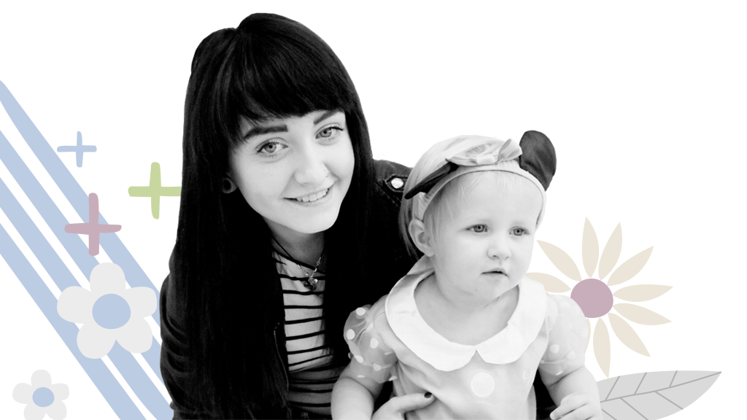
Partners in Parenting Practice (PIPE) ELEARNING PILOT

Slide 2
Welcome, housekeeping, tech check
This Photo by Unknown Author is licensed under CC BY-SA
Notes:
Welcome, tech check, mics, chat function, raise hand etc (if participants have not attended the “orientation to e-learning session” please take time to orientate participants to the platform
Where possible have at least 2 educators; 1 to present, 1 to monitor and respond to chat, Business support colleague will provide IT support on the day and will note contact number on learning schedule (see separate handout)
Reminder that should IT fail phones can be used, if need to leave meeting please add to chat so that we know everyone is safe
Small group/break out rooms will be used, check everyone is happy to use these
Reminder to have schedule minimised to the task bar to enable easy access to small groups
Offer reminder about how to mute notifications in chat

Slide 3
Hopes and Expectations
This Photo by Unknown Author is licensed under CC BY
Please share in the chat what you hope to learn and what your expectations are for PIPE
We will review it at the end of the session
Notes:
Establish positive and collegiate learning environment, reminder that we all have different learning styles and this continues to be an important consideration on a digital platform
Highlight that PIPE is a journey with smooth road, hills, pot holes etc
If everyone has access to GIF function invite participants to add a GIF to the chat to share how they are feeling about PIPE
Educator allocated to Chat to summarise and reflect general feeling to presenter
It would also be possible to use JAMBOARD https://jamboard.google.com/ to create this and a What helps us learn that can be downloaded and retained

Slide 4
What helps us learn?
Notes:
Facilitate a discussion for What Helps us learn to identify any particular learning styles and needs.
Invite participants to add to chat or if numbers are small facilitate discussion, capture reflections and create wordart in coffee break (www.wordart.com)
Invite participants to choose their strength for the day from Strength card slides, reminder to keep this to hand and to consider how they will use this strength to help them through their learning

Slide 5
STRENGTH Cards
Notes:
The Strength cards slides are too large a file to share, please use your local version

Slide 6
Learning Outcomes
By the end of this learning participants will be able to:
Day 1 online: Integrate a critical understanding of the underpinning theories, concepts and principles of the PIPE model
Day 1a online: Critically reflect on how PIPE is integrated into visit content
Protected learning time: Construct an original and creative individual PIPE lesson plan outlined in a specific FNP visit guideline
Day 2 virtual observation: Demonstrate a complete PIPE lesson using a range of communication skills to conceptualise abstract ideas to the client in an accessible way
Notes:
Provide a brief overview and outline of what will be covered over the two half days online.
Explain that the experiential/skills practice element will be explained fully at the end of the online learning with an opportunity to ask questions

Slide 7
The PIPE Philosophy
The PIPE curriculum and model are designed to draw on the strengths of the parent to help them become more emotionally available
PIPE believes that the skills of emotional availability can be learned and will be internalised if parents have the right information and the opportunity to practice with the support and knowledge of a trusted family nurse
This sharing and caring can lead to a new and enduring internalised model of behaviour
Notes:
1st bullet – You are all aware of how important it is that parents are emotionally available for their infants and what can happened if this does not take place and you explored this in detail at Next Steps training
In addition, in Foundations in FNP training you heard about the teenage brain and we know that they can find it particularly difficult to read emotional signals from their infants and contain their own emotions, hence being available for their baby. As adults we use well developed sophisticated parts of the brain that are capable of reasoning, however teenagers use the less well developed part of their brain which is also used for fight / flight/freeze (reptilian/snake brain)
Invite participants to either use raise hand function or chat box to share what they can remember about the importance of emotional availability
Key points: attachment security, regulation, mastery, ready to learn,
2nd educator to review chat box, summarise and reflect key points to group
2nd bullet- PIPE highlights that emotional availability can be taught and the key here is “Practicing” time and time again, Can you imagine what a gift you will be able to offer your clients? Emotional availability can be taught, link here to those who may have experienced trauma/domestic abuse and the benefit of PIPE
Cf Journal of IMH article (War lingers on: highlighting the need to re-establish attunement between mothers who have experienced trauma and their children, relevance to trauma enhanced practice discussed in foundations)
https://onlinelibrary.wiley.com/doi/epdf/10.1002/imhj.21324
3rd bullet- then with practice and coaching this can be internalised, focus on “enduring” reminder that FNP is a behaviour change programme and we want to support sustained change

Slide 8
PIPE curriculum and model
PIPE curriculum is made up of 3 components
Educators guide- this is your KEY reference resource when planning PIPEs
Parent handouts- support the delivery of PIPE
Activity cards- provide creative ideas for delivering PIPE
Notes:
Over today we will be making use of all the PIPE materials, have to hand and ensure that you can visualise them on screen.
If necessary use photos and share screen
Hold up educators guide and highlight how important this will be and how well they will get to know it – use an old copy!!
Hold up parent hand-outs, reminder re CD rom/shared drives
Hold up activity cards (HIGHLIGHT THAT THE ACTIVITY CARD NAMES ARE ALSO WITHIN THE BACK OF THE EDUCATORS GUIDE)
Reassure everyone that they will get used to using a different “PIPE” language over time

Slide 9
Reviewing your pre-learning
We are using a quick quiz to get our heads into PIPE!
This Photo by Unknown Author is licensed under CC BY-SA-NC
Notes:
Quiz has been created on Forms in Teams, if numbers are small this can be done as a quick fire round, first to raise their hands/add to chat
Alternative is to use Chat and Hold (ask participants to type their answer but not to send until Educator says “Go”
Otherwise use Quiz on forms (in own tab on Teams)
Quiz to check learning from prep pack.

Slide 10
The 8 emotional development concepts(threads) Small group work
Autonomy
Regulation
Attachment
Emotional refuelling
Shared positive emotions
Trust
Communication skills
Temperament
Please spend 10 mins exploring how the emotional concepts you have been allocated build resilience within families
Identify someone to feedback 2 key points
Notes:
Go through each one facilitating a discussion around why the group feel these are important in helping to build resilience within families
Highlight that EVERY PIPE topic will address at least one of these threads
Small group work: in groups of 3 (separate channel on teams required for breakout) please spend 10 mins exploring how the emotional concepts you have been allocated build resilience within families)
Elicit “building good family relationships supports the child to become confident and resilient”
Use Whiteboard or JAMBOARD to capture feedback (additional educator to do this)

Slide 11
Overview of the Units
Listen- this supports clients to consider and understand their baby’s cues
Love – this unit is helpful in reinforcing all we know about developing secure attachment, emotional connectedness, sensitive and responsive care giving
Play – this unit works with the basic drives that motivate children to learn. This focuses on understanding how be non-intrusive, allowing children to take the lead
Notes:
Listen: P21- topics
This unit is a good fit with understanding your baby’s signals and links well with DANCE- explore a couple of examples if there’s time- baby cues, patterns and expectations and read a few sentences from the manual that highlights the importance for parent and/or child.
Ask participants if they can think about how these are important for parent/child, use chat function or hand raise for feedback
Love
P 161
-
This unit is useful in relation to all we know about developing secure attachment, bonding, emotional connection, responsive care giving.
Parents that are able to consider their feelings and those of their infant will be able to understand their child's emotional signals, understand the need for regulation and are better able to meet their baby / toddlers needs and will feel more successful as parents
PLAY
P353
This unit works with the basic drives that motivate babies and children.
We know that children learn many things through play and this unit helps parents to get involved and enjoy play- to be available, attuned and scaffold their child's learning, as well as understanding how not to be intrusive, allowing their child to lead (we will talk more about this later).
Within the play unit it doesn't just address play it addresses all interactive experiences and hence is another good link to Dance
Refer to Vygotsky play theory in relation to this unit highlighted how it correlates with the other two. (for reference see
Scharer J (2017) Supporting Young Children’s Learning in a Dramatic Play Environment
Journal of Childhood studies, 42 (3) pp 62-69

Slide 12
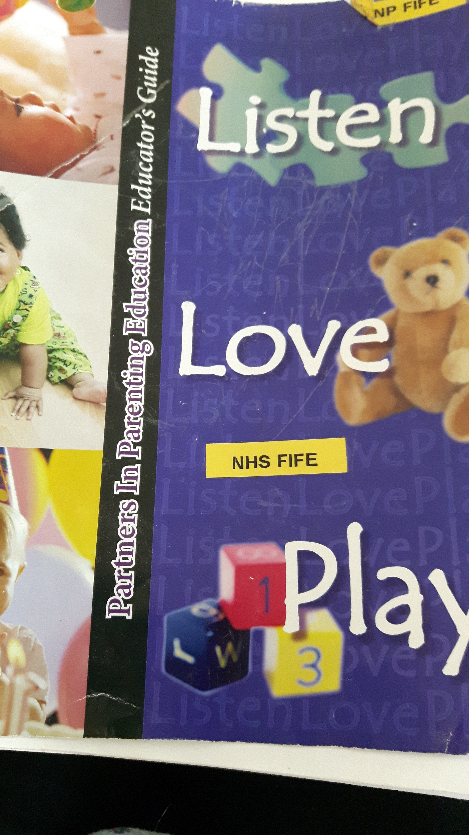
Getting to know the Educators Guide
You have been given a specific topic within a specific PIPE unit to consider
Please be prepared to feedback on the questions you are asked to consider
Notes:
Each nurse will be given a topic to consider: for online version, add to files, where possible send in advance, if numbers are very small, consider doing this as a flipped classroom
1: Listen: Patterns and Expectations
2: Listen: Baby cues
3: Listen: Cribside Communication
4: Listen: Reading to Baby
4a: Listen : tune in tune out (added for Sept 2020)
5: Love: Joy and Laughter
6: Love: Touch Tones
7: Love: Love and Limits
8: Love: Love is sometimes a rocky road
9: Play: Playing is learning
10: Play: Baby’s First Teacher
11: Play: Learning the Dos
12: Play: Play stimulates the senses
The following is contained within a doc in files on TEAMS
Each nurse will be asked to find the following:
What page does their topic start on?
Name one KEY CONCEPT the topic addresses
Identify one activity suggested on the activity cards
Consider when this would be useful to explore this topic with an FNP client?
Share one thing you liked about this topic

Slide 13
Break
This Photo by Unknown Author is licensed under CC BY

Slide 14
What does a PIPE look like?
FILM
This Photo by Unknown Author is licensed under CC BY-SA-NC
Notes:
THIS IS THE UPLOAD VERSION SO NO FILM IS EMBEDDED HERE. LINK TO TURAS FILM 6 ON PIPE FILM DIRECTORY
Highlight the need to look at the FOUR STEPS, can be helpful to ask participants to turn to the page in the educator guide and follow as they watch
Provide context for this video (done with no rehearsal!) reminder to view this with the generosity with which it is shared
This will provide us with a PIPE that we will take Step by Step to learn how to use the PIPE curriculum throughout the day
Pay particular attention to the activities used as you will be completing these late

Slide 15
Step 1 Presentation of Concepts
Introduction of topic-
this creates a relevance for the PARENT
Key Concept
this creates a relevance for the CHILD
This Photo by Unknown Author is licensed under CC BY-SA-NC
Notes:
So now we have seen what an entire PIPE looks like, let’s deconstruct it and then build it back up
There are two parts to step one - first the introduction of the topic I’m going to teach the client creating relevance for her and second the key concept which links this topic to the baby helping the client to consider what it might be like from the baby’s point of view
If Step 1 is done properly the rest is plain sailing
We are going to use one specific PIPE (the one you have just viewed) to enable you to build your confidence in planning a PIPE. We are using LOVE unit, Topic 6 (attachment). This may be a PIPE you have already seen being used

Slide 16
Introduction of topic: relevance for parent
Parents need to be emotionally available for their child; develop mind-mindedness
By exploring their feelings about a particular area of parenting enables the parent to explore any unresolved issues
We can use these to help them understand how their baby might feel
Notes:
This element of Step 1 supports our approach in FNP about being mind-minded. In the introduction to the topic we are helping parents be emotionally available for their infant and develop their capacity for mind mindedness.
parents’ mind-mindedness—the ability to ‘tune in’ to their young children’s thoughts and feelings.
Research has shown that ‘tuning in’ to what your baby is thinking and feeling—in other words, being more mind-minded—means that your child is more likely to be securely attached, have better language and play abilities at age 2, and better understanding of other people’s thoughts and feelings when they start school. Being mind-minded when your child is a baby also means that your child will be less likely to have behaviour problems in the preschool years. Parents who are mind-minded also find parenting less stressful.
If we allow them to explore and consider their own emotions, perhaps even what's affecting them they will then be able to consider ways of resolving any issues they have. this will then help them be more emotionally available for their infant, be able to hold their infant in mind, increase their own emotional intelligence for life and hence be more able to understand what their child may be feeling, as well as being able to deal with strong emotions their child may generate
We use a fun activity to introduce the topic to help engage the parent’s inner child.
What activity did you see used in the PIPE film to introduce the topic (accordion paper folding activity)

Slide 17
Love: Topic 6 Attachment Introduction of topic
As humans we have a deep need for a feeling of attachment, a need to feel committed and connected with another
Each person maintains a unique identity but becomes stronger as a result of an emotional connection to another
Notes:
Love unit
Now please turn to page 253 in your educators guide- We’re going to spend some time working through this whole topic together topic 6 (Attachment) to unpick the model. We’re going to walk through each step in turn and break it down into its finest parts. Please go with me, suspend your assumptions and as we put each step into practice, one at a time it will become clearer.
Do feel free to ask questions as we go its just that I may ask you to hold on to it as it m
Looking at p253- you will notice:
This is the first page of this topic and for each of the 28 topics this page has the same format. The inquiry questions are designed for a number of things: to support you with ideas for phrasing questions, can be used with the client, focuses your thoughts on the topic and are in the parent hand-outs, which we’ll look at later.
P255 – gives you the Conceptual overview- this, in essence, provides you with all the additional background information you’ll need. It gives you the knowledge base so that you are ready to teach the parent- in this instance it’s about the development of language. You’ll notice that there are 5 points in this conceptual overview and we would only ever use one of these when we teach a client.
P257 shows you the tools and materials you may need for this session- e.g. additional terms to understand, which activity cards are relevant and what other materials you will need for this topic.
P258 lists the parent hand-outs you can use. These are in the parent hand-out folder (HAVE THIS READY TO HOLD UP). You’ll notice the # mark before each hand-out. This is the American symbol for number so its telling you which page in the hand-outs you can find each one. You’ll also notice the picture of animal artwork which was mentioned yesterday. At least one hand-out in each topic is animal artwork and it can be a great way of discussing emotions and interactions.
P259- gives you an instructional teaching plan which is the 4 step model. It starts with the learning outcomes (as all teaching plans would do) and then walks you through the topic in 4 steps.
In this topic there are 3 learning outcomes of which you would choose only one that you think suits your clients needs, based on a previous visit or a Dance observation which adds to how we agenda match with clients.
Then you’ll see the Step 1, the presentation of concepts which as I’ve said provides the knowledge for the parent and creates topic relevance for her and her baby.
Next slide

Slide 18
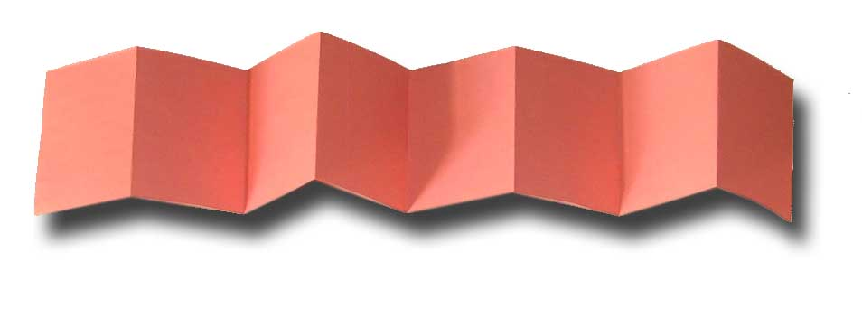
Trying an activity out
Notes:
You will have noticed that the activity that was suggested to introduce the topic involved paper folding as we saw on the film clip. We would now like you to have a go.
In pairs read the instructions on page 259 and take turns to do this activity as a Family nurse and as a client. If you are the client, please be kind!
You will be given paper in two different colours, one represents the client and the other the person she can identify as being attached to.
Participants have been asked to have two strips of different coloured paper to hand

Slide 19
Step 1 Presentation of Concepts: relevance for child
Key concept
Biology ensures that most parents are committed to protecting and providing for the needs of their infant
Sub concept: This attachment begins at birth and is a unique relationship
Notes:
Now we’re going to move on to the Key concept so looking at p260 and remember we are still in step 1 we’re now going to think about how it feels for the baby.
You will note there are 5 key concepts given and again you will only ever choose one.
READ OUT EACH TITLE and we’re going to focus on the second key concept which is “Biology ensures that most parents are committed to protecting and providing for the needs of their infant” at the top of page 260. Again to help you this has been broken down into 1 sub concepts- “This attachment begins at birth and is a unique relationship” .
Notice there is only one possible instructional strategy (the open box) however sometimes you are given a choice of how to teach it and we are using topic animal artwork (highlight that each artwork is shown at the beginning of the topic. Educator reminds delegates how the animal artwork was used in the film clip
Animal artwork added to files (or add to chat on the day). Participants to download (can be sent in advance if necessary) or access a copy at site. Divide into pairs and invite participants to use the animal artwork with their colleagues exploring how they would introduce this to clients. (allow 15 mins, 5 mins each and 5 mins to share key learning)
3 key things they have understood following an exploration of Step 1: looking for: 2 parts/intro of topic creates relevance for parent/key concept creates relevance for client, activity needs to be fun and focused, may have choice for instructional strategy, choose one

Slide 20
Notes:
Check in to see how everyone is feeling,
Take 10 mins to invite participants to share 3 key things they have understood following an exploration of Step 1: looking for: 2 parts/intro of topic creates relevance for parent/key concept creates relevance for client, activity needs to be fun and focused, may have choice for instructional strategy, choose one

