Slide 1
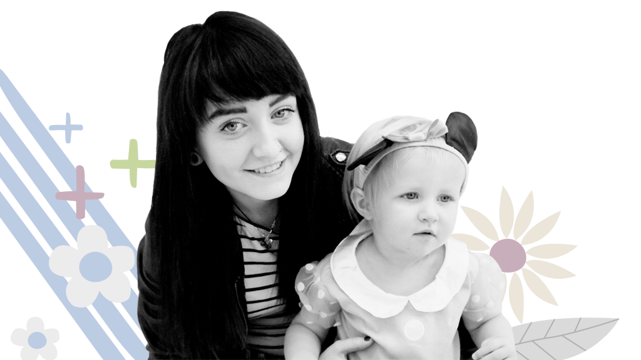
Partners in Parenting Education Step 2
Notes:
Steps 1 and 2 can be completed over the first half day session online (session length 9.30-1pm)
Check everyone has access to a PIPE doll and scarf for peek a boo

Slide 2
LEARNING A NEW SKILL
Consolidation
STEP 4
Hands- On
Demonstration
STEP 3
STEP 2
The Big Picture
STEP 1
http://tlt.its.ssu.edu/suggestions/research/How_People_Learn.shtml
Notes:
When learning a new skill we need to look at what helps us to learn and why important. We need to think about the fact that we don’t know what we don’t know and this is why we introduce the topic in step 1 so parent receive information about a new skill, which is the presentation of concepts. Then we need to see it done which is why we role model and show- this is especially helpful for visual learners. Step 3 is having a go and step 4 is evaluating how it all went, both of which will be covered later.
Pipe uses play activities and care taking routines to provide opportunities for parent child to interact positively with each other, practice new skills whilst having fun i.e. Teachable moments

Slide 3
Demonstration…..why bother?
The demonstration is crucial to the success of the interactive session. It is the bridge between theoretical learning and real life application
Bandura’s Social learning theory
Provides a visual picture of the activity (Visual learners)
Parents feel more confident when they can see how the activity should look like
This Photo by Unknown Author is licensed under CC BY-SA
Notes:
The demonstration is crucial to the success of PIPE. Many clients need examples of “how to be” with their child or what “good” looks like so this is your chance to demonstrate. You will remember from day one how important positive interactions are for infants and their development, as well as considering the additional needs for support that teenagers may have. This is in part due to their brain development being “work in progress” and partly, due to their life circumstances e.g. a lack of positive role models, poor life history etc
Bandura: observation, imitation, modelling (brief overview reminder of what was covered in Next Steps)
So lets see what happens if you don’t demonstrate-

Slide 4
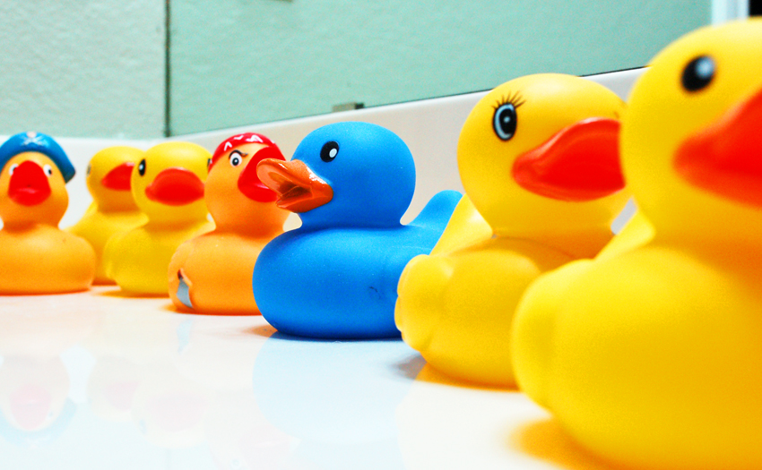
Ducks in a row
DVD
Notes:
Unfortunately this DVD can’t be embedded into the presentation
Show DVD “Ducks on the table”, ask for some brief feedback about what the family nurses are seeing in the film, invite them to consider the relevance for clients
Use screen share function
If unable to show this film, invite participants to reflect on how the paper folding activity would have felt if they hadn’t seen it?
Then invite them to consider how clients may feel if they have never observed play, capture this feedback linking back to learning theory

Slide 5
Preparing for the Demonstration
Remember that you are role modelling what you want to see
This includes “checking in” with the baby to make sure the baby is ready to play
Is the baby ready? Is the parent ready? Is the room ready?
Remember to close the activity once the child signals they need a change or have had enough
Notes:
Reflecting back to the PIPE video you saw earlier, invite participants to consider what they noticed the nurse do as she began the demonstration,
Bullet points come in on click
Offer opportunity for feedback on the film, looking for key points outlined in bullet points

Slide 6
What do you feel will help you to demonstrate?
Spend 5 mins thinking about what will make you feel comfortable about demonstrating an activity to your client?
Please add your thoughts to the chat box.
We will share our reflections
This Photo by Unknown Author is licensed under CC BY-NC-ND
Notes:
Take some brief feedback
Try to elicit: feeling comfortable with the doll, skills practice, modelling what they want to see, using the doll early in the programme to demonstrate a range of activities etc
Consider using google jamboard to capture thoughts to offer change of engagement method
https://jamboard.google.com/

Slide 7
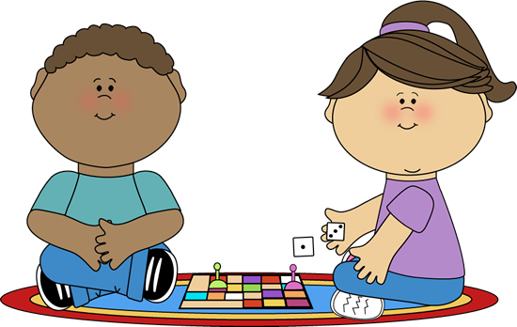
Choosing an activity to demonstrate
What: think about the message you want to convey
Why: why is this important?
How: think about an activity that is
Easy to explain!
Developmentally appropriate
Correlates to the concept being explored
Doesn’t need too much equipment
Remember the activity cards can be helpful here
This Photo by Unknown Author is licensed under CC BY-SA-NC
Notes:
Work through slide, outlining the three things to consider, What, Why, How, offer reflections from own practice

Slide 8
Demonstration
Please read page 266 in the Educators Guide
Peek a Boo
Notes:
Need Doll and scarf, this was included in the pre-learning information

Slide 9
Trying it out……….are you ready?
Let’s get a sense of how you are feeling?
On a scale of 1-10, 1 being “nope I’m not feeling ready at all!” and 10 being “I’m soooo ready to give this a go”….where would you place yourself?
Please add to the chat box (if you feel ok to do so)
If we’re ready let’s have a go!
Notes:
On a scale 1-10 how motivated are you to try the demonstration, consider using mentimeter/forms on Teams for this to keep it confidential
Invite them to use a break out space to demonstrate peek a boo with a colleague (channels or break out rooms set up in advance)
Offer gentle reminder to ensure camera is angled to enable colleague to see the demo
Allow 15 mins for demos

