Slide 1



Sensitive Enquiry and Response in FNP Practice
Pamela Murray (Scottish Government)
Marion McPhillips (NES)

Slide 2
Learning Outcomes
Recognise how national guidance has been operationalised within FNP practice.
Develop an understanding of the pilot education facilitated for two teams
Understand the next steps in this QI project.

Slide 3

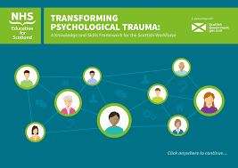
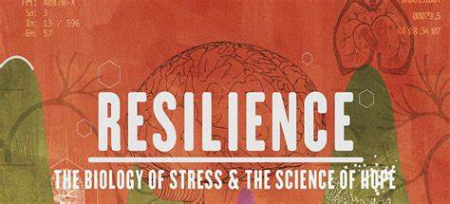
Background

Slide 4





Sensitive Enquiry and Response

Slide 5
Developing Education to Support Practice
Education Subgroup
Pre education questionnaire
1 full day, face to face

Slide 6
Pre and post education questionnaire
Scaling Question 1-5
Where 1 is not at all confident and 5 is very confident
Pre Ed number of respondants:12 (100%)
Education participants = 9
Post Ed number of respondents: 5 (55.5% therefore not generalisable)

Slide 7




Individuals “reactions” to education
Your Lightbulb moment! Learning how someone used a facilitator in skills practice- she drew a picture on it 😊 How much we are already equipped to carry out trauma informed practice. We are an intervention in ourselves. The different ways in which trauma can affect an individual, how big or small. | What are you taking away? Straightforward explanations of trauma for the clients . How to prepare for the visit where there may be a conversation about trauma. New tools to help facilitate discussions and confidence in discussing trauma. The information was so informative. Love the new facilitators. Confidence to go for it and explore effects of trauma more.
What did you like? The size of the group for training day was really good. Presentations and educators were all great. Skills practice was fab. Liked the different styles of learning today. I enjoyed the whole day experiencing skills practice. | How are you feeling? Feeling good and well informed after today. Feeling very positive and uplifted. Feeling energised. More knowledgeable and confident. Happy and relieved. Relief & optimism about taking forward.

Slide 8
Next Steps
Consider adaptations
Sustainability
Client voice
Trauma-Informed Practice: A Toolkit for Scotland

